Slide 1
Telecom
Customer Churn
Team-2R
Insights:
Merin George(20BDA11)
Alex Paul(20BDA66)
Ranjith Kumar(20BDA56)
Rakshith Kumar(20BDA47)
Nagavarun.S.N(20BDA67)

Slide 2
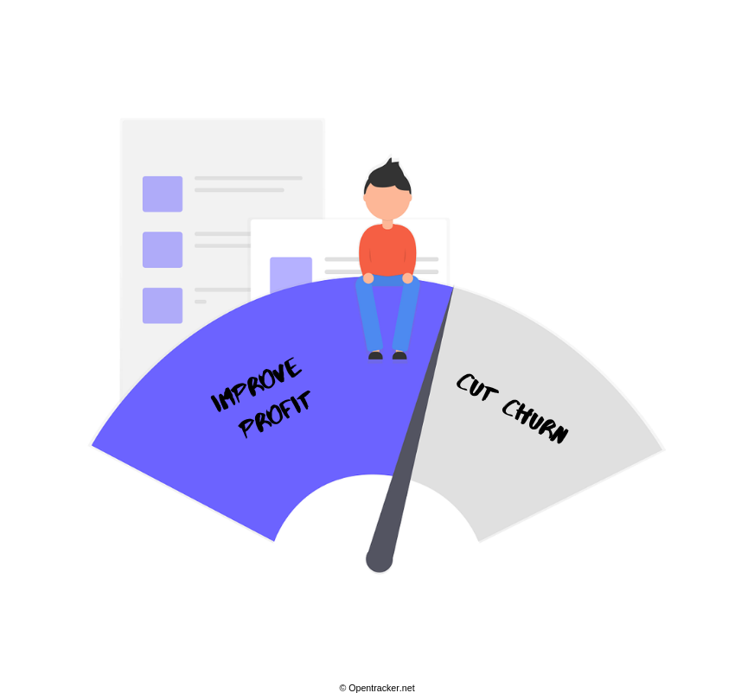
What is Churn .
Customer churn occurs when customers or subscribers stop doing business with a company or service, also known as customer attrition. It is also referred as loss of clients or customers. One industry in which churn rates are particularly useful is the telecommunications industry, because most customers have multiple options from which to choose within a geographic location..
Next Page

Slide 3

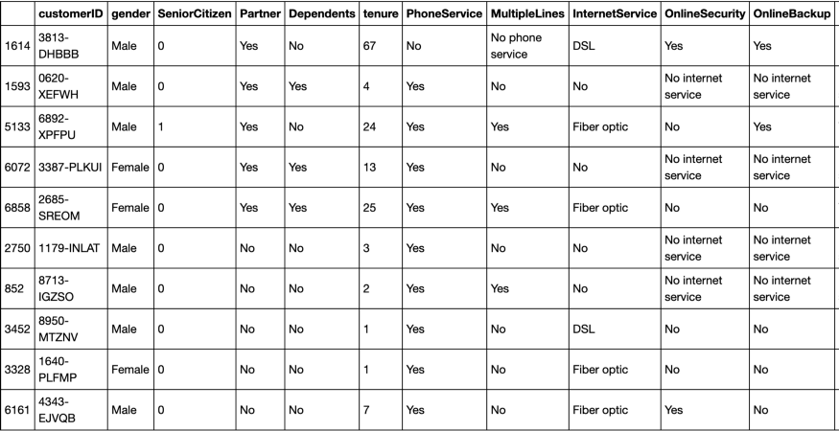
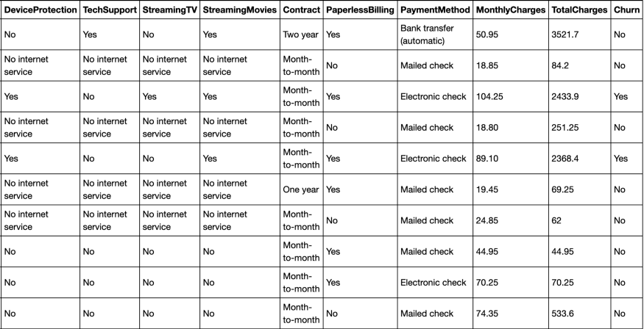
WHAT ABOUT DATASET
The data set includes information about:
Customers who left within the last month – the column is called Churn
Services that each customer has signed up for – phone, multiple lines, internet, online security, online backup, device protection, tech support, and streaming TV and movies
Customer account information – how long they’ve been a customer, contract, payment method, paperless billing, monthly charges, and total charges
Demographic info about customers – gender, age range, and if they have partners and dependents
7043
unique values
Male50%
Female50%
Fiber optic44%
DSL34%
Month-to-month 55%
Two year24%
Electronic check 34%
Mailed check 23%

Slide 4
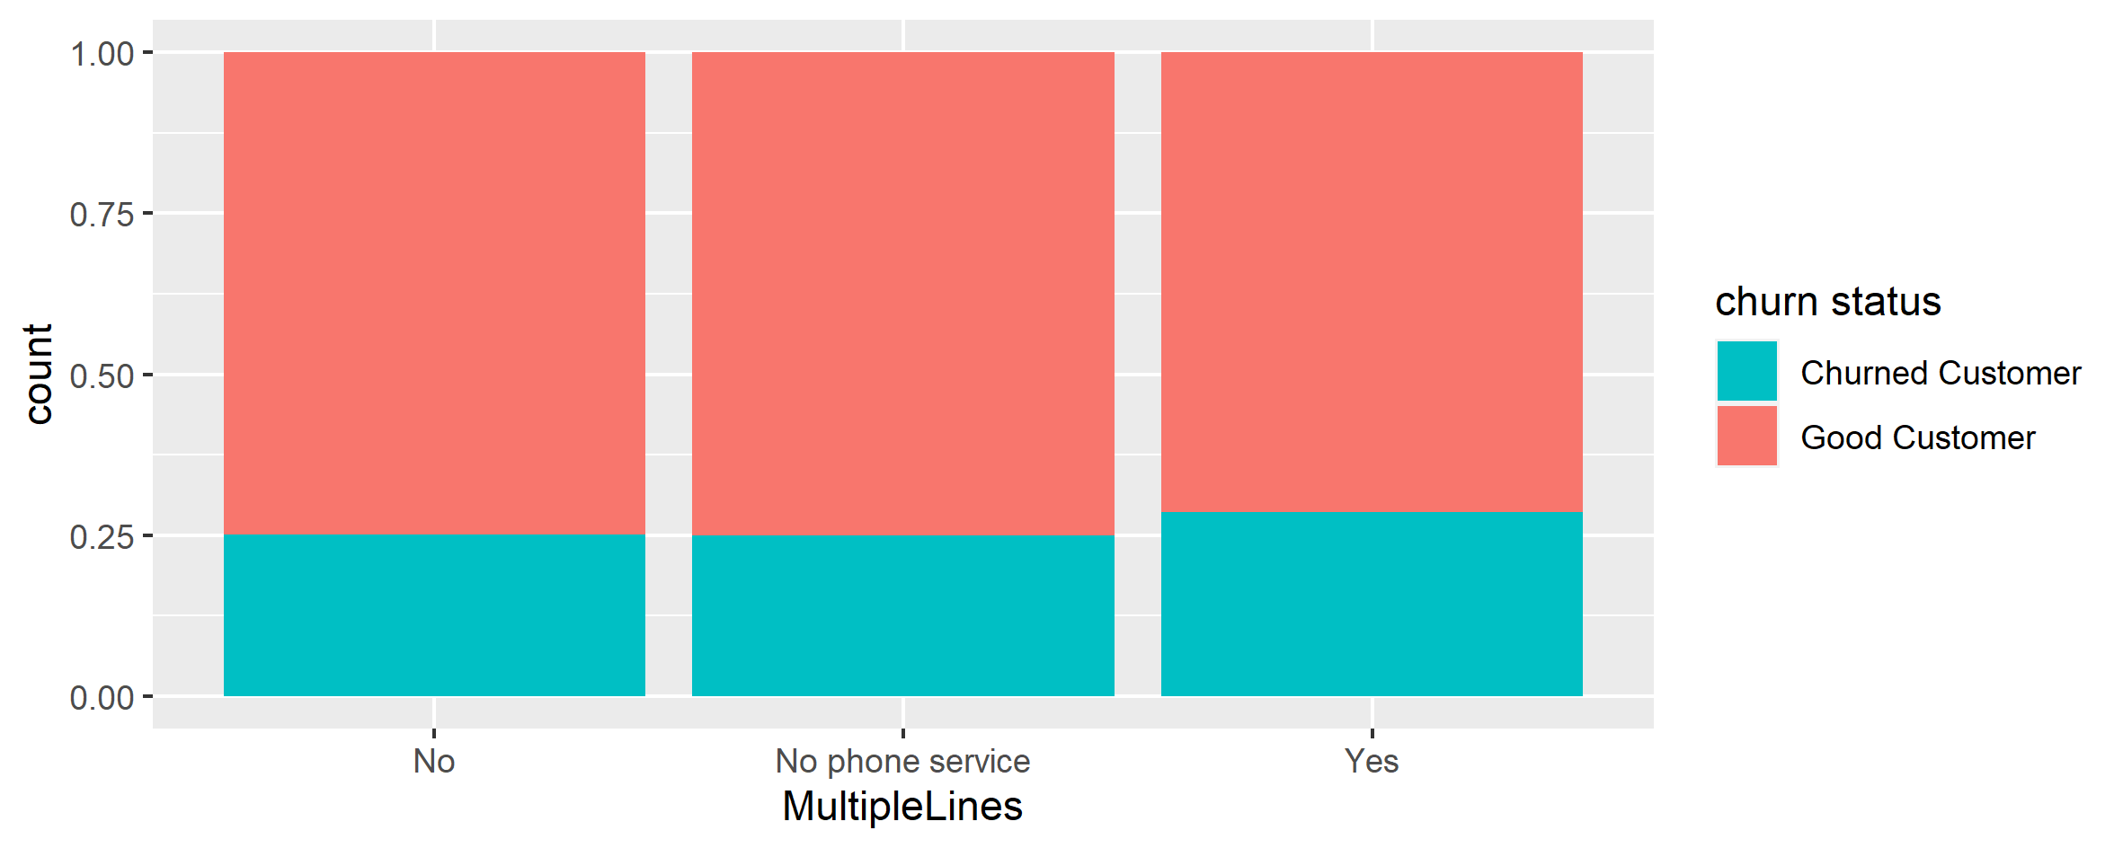
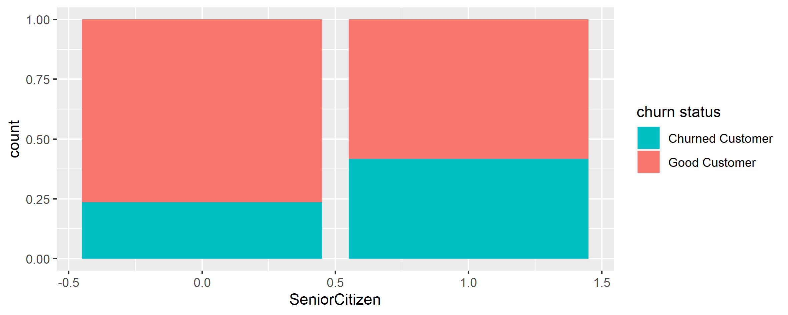
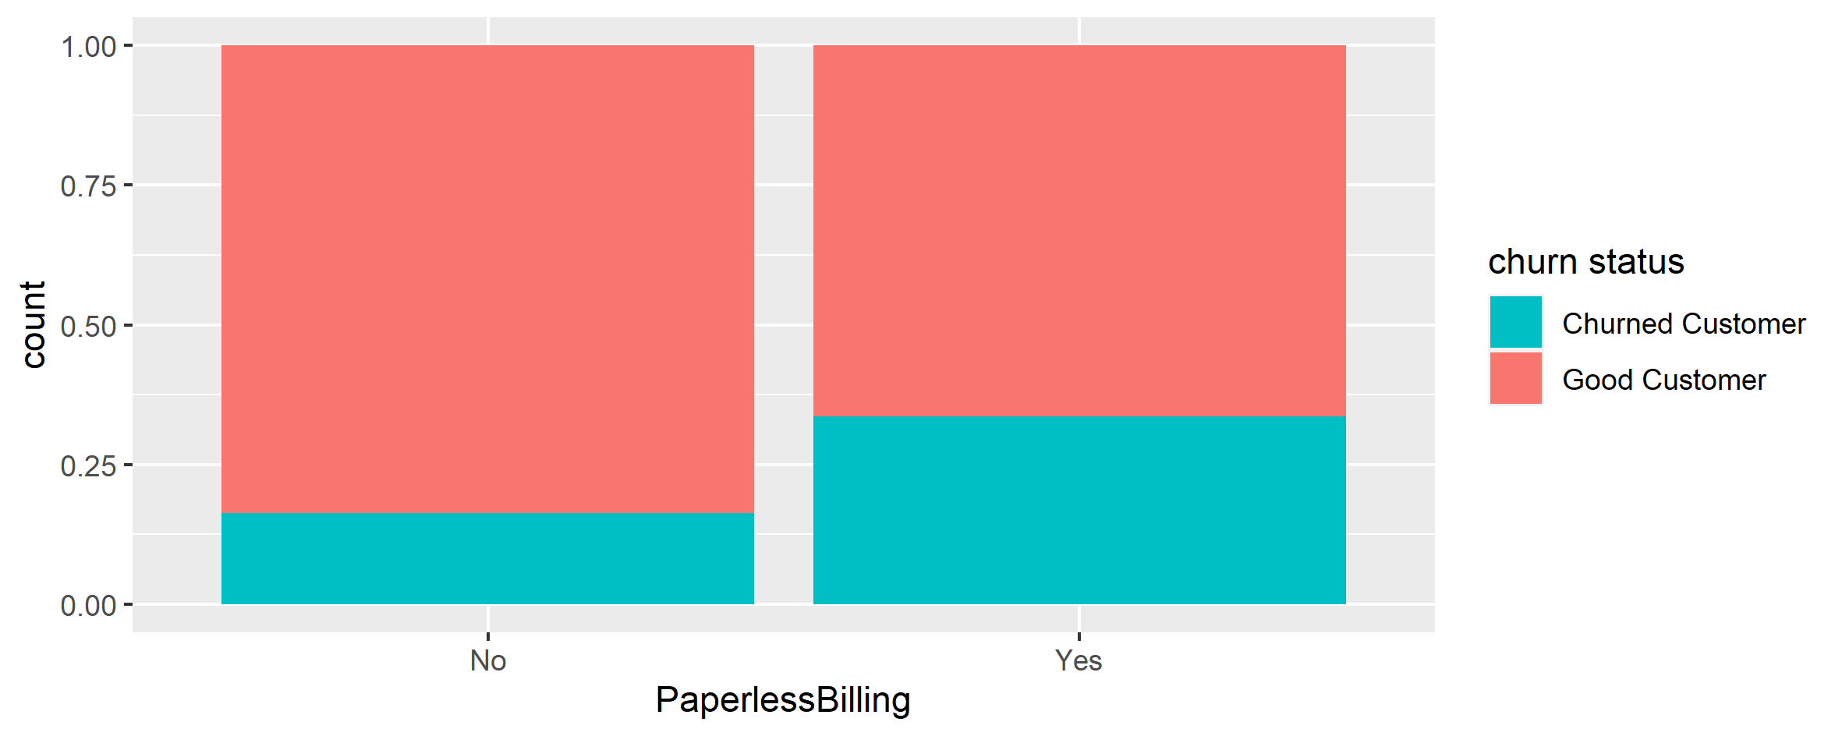
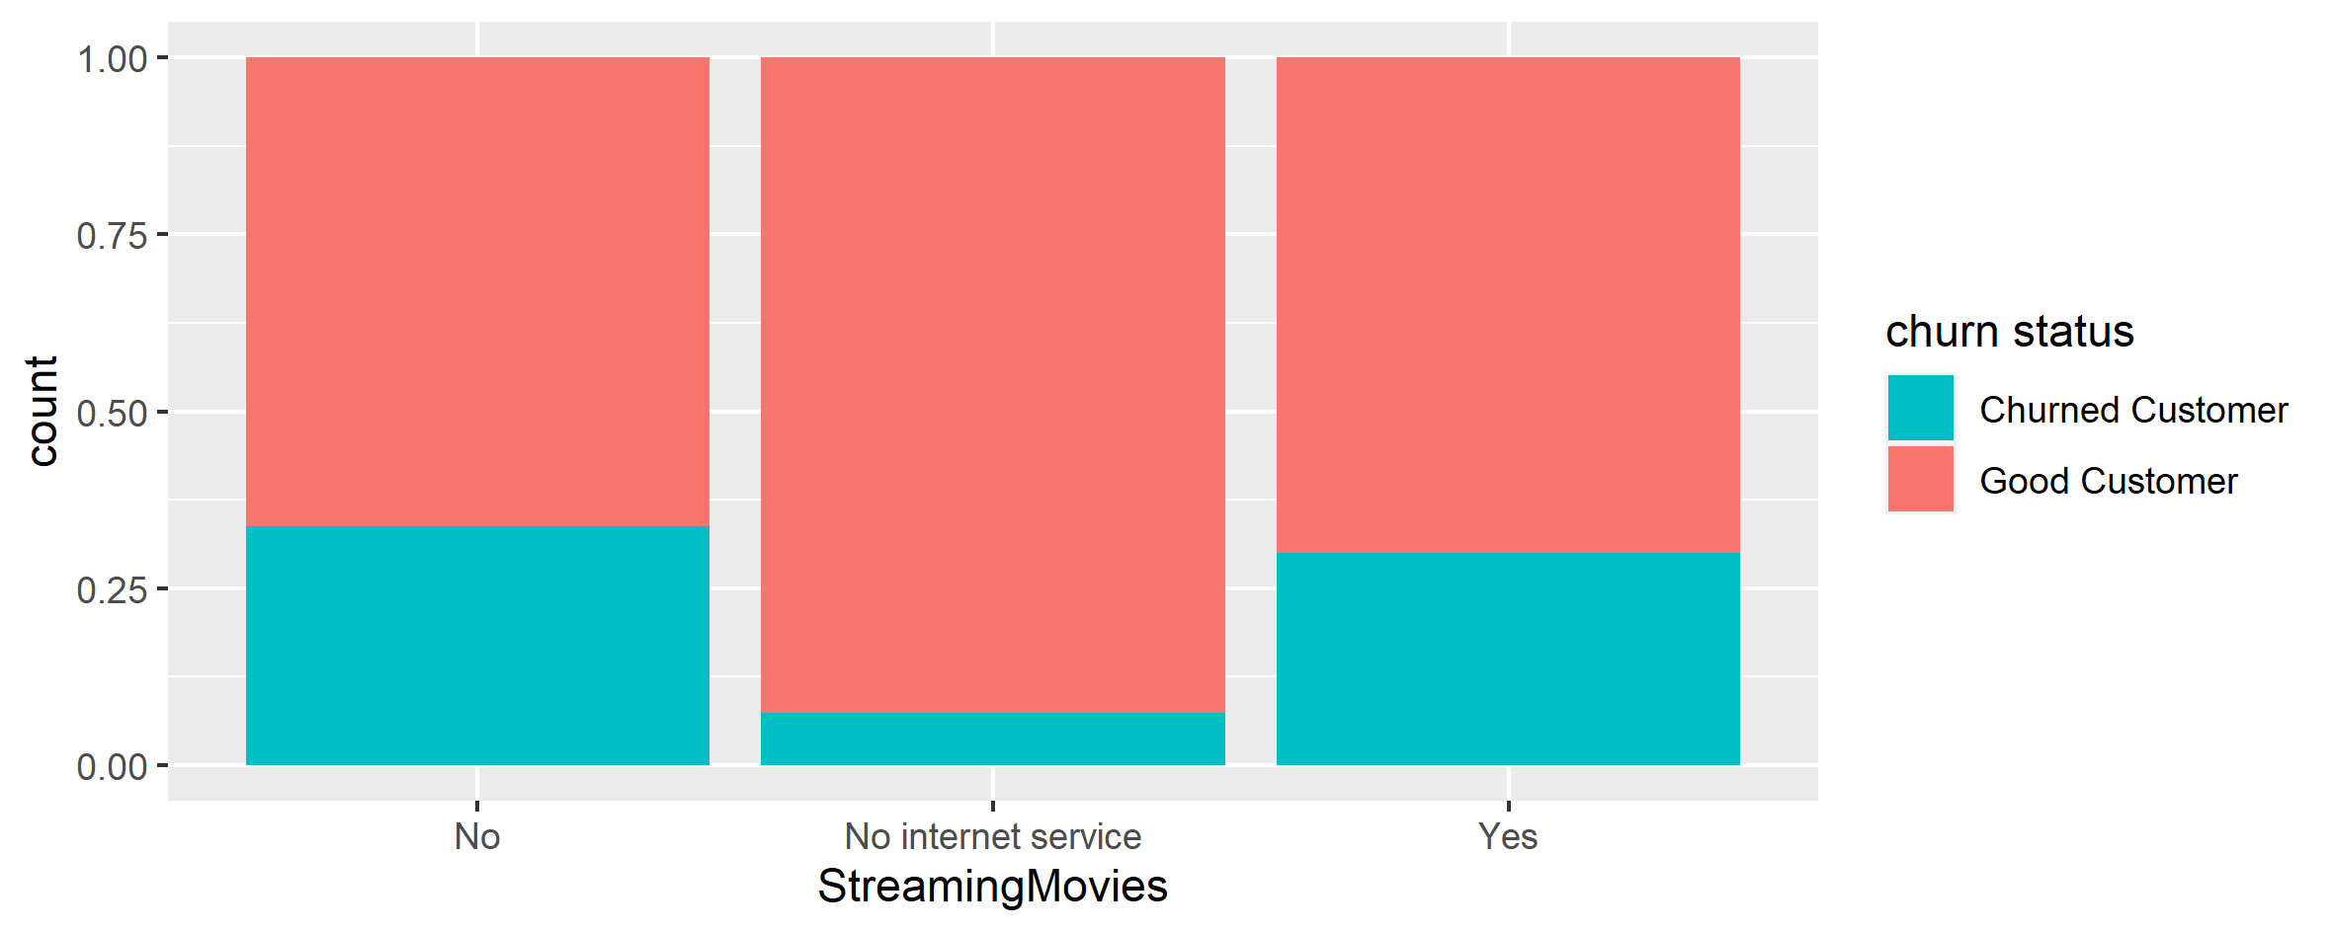
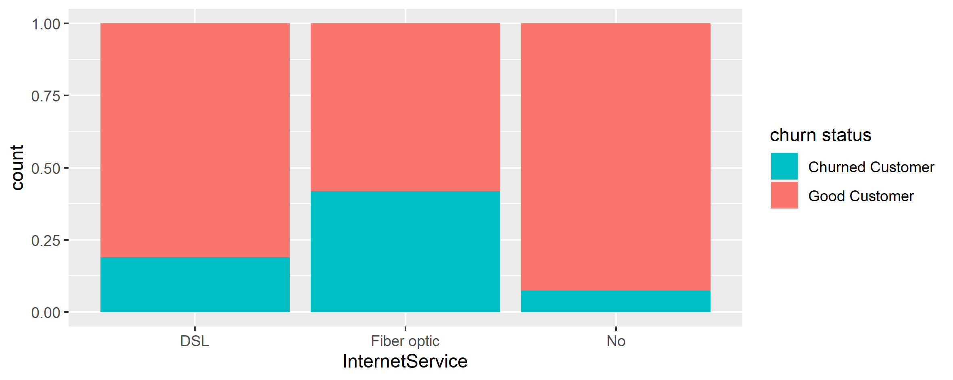
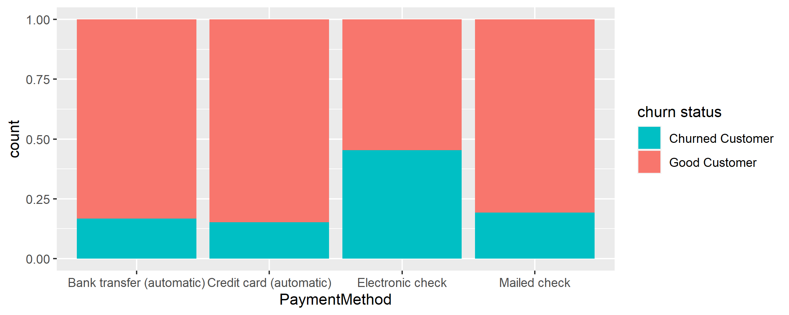
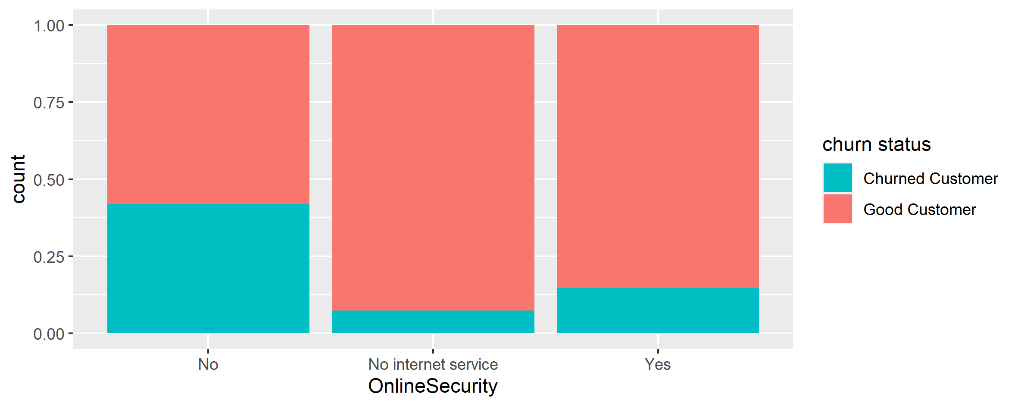
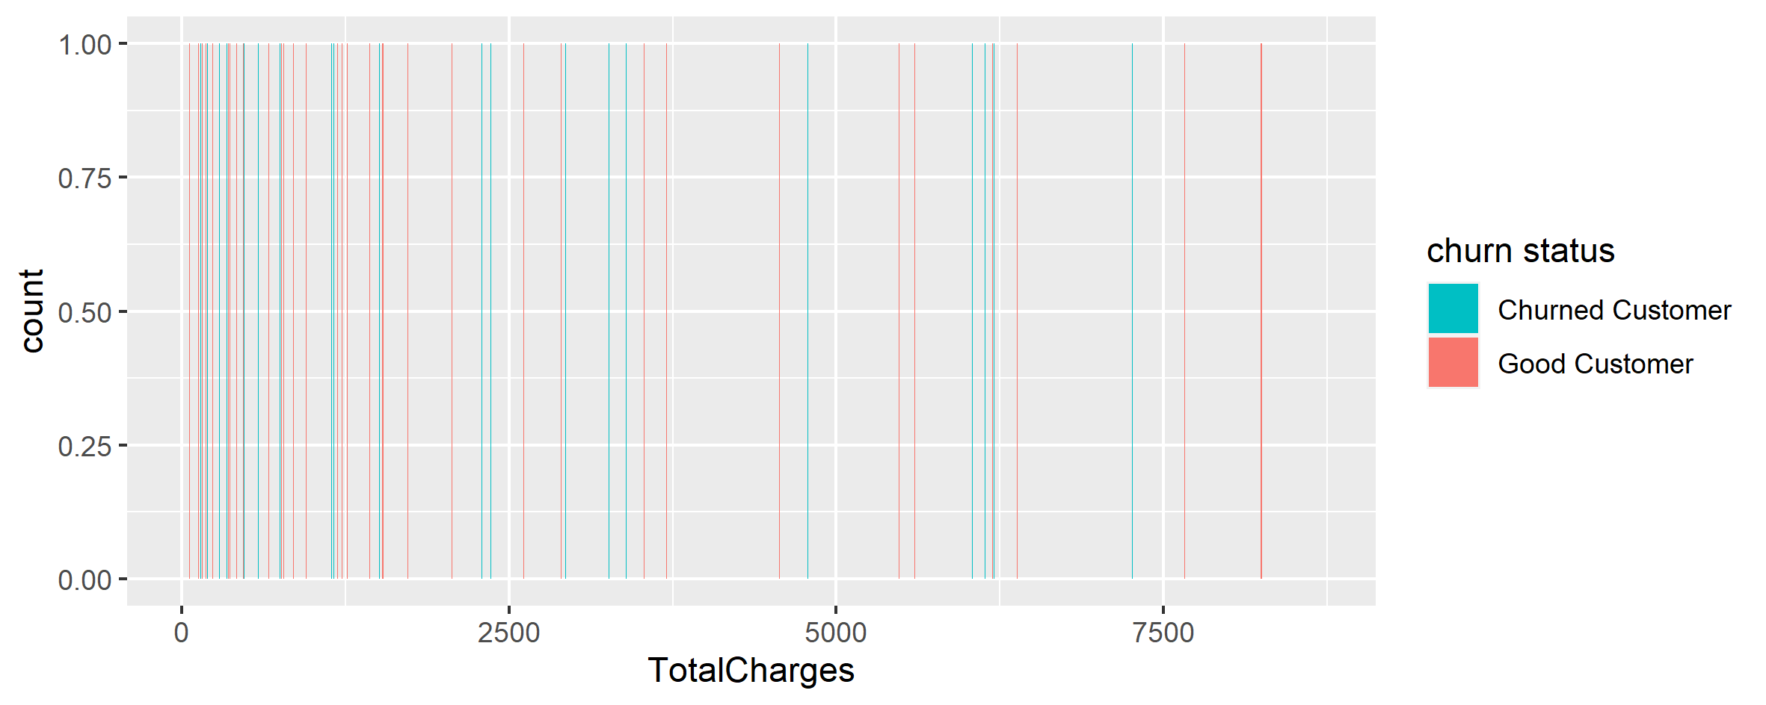
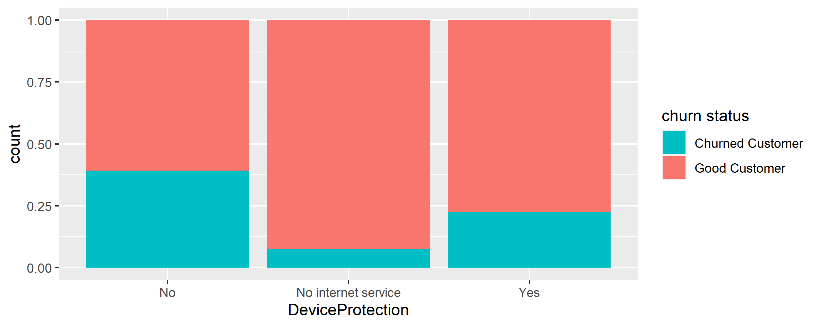
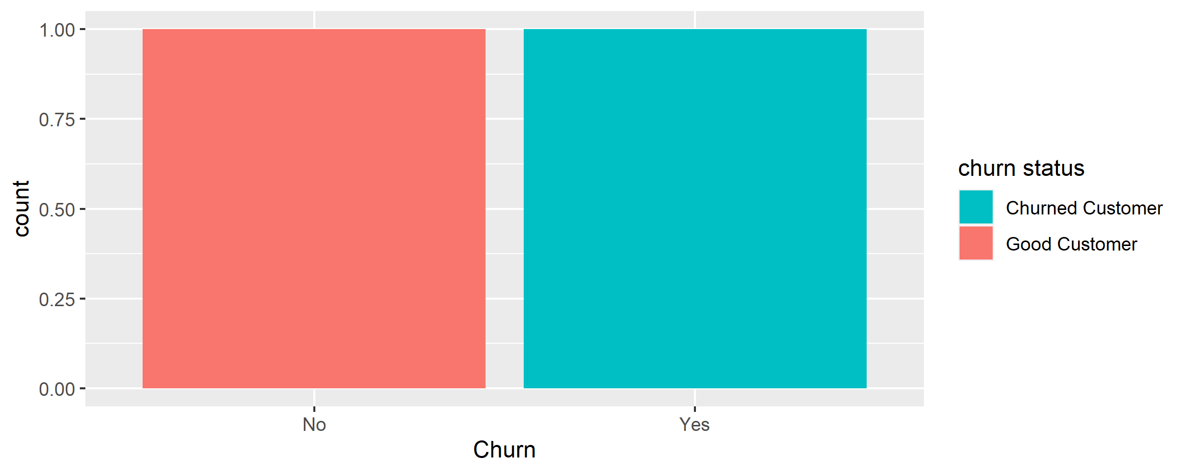

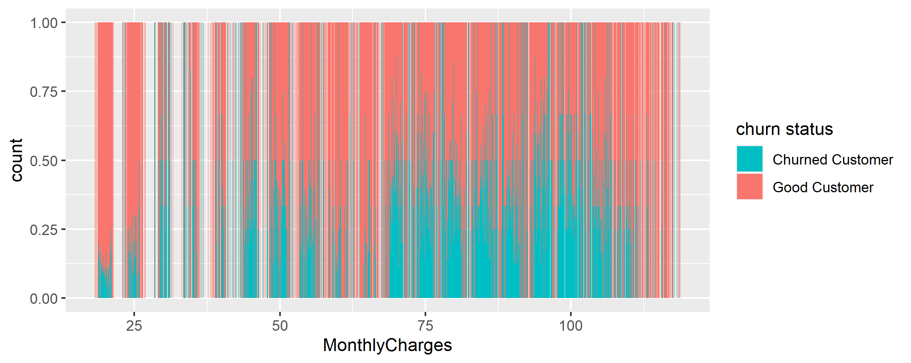
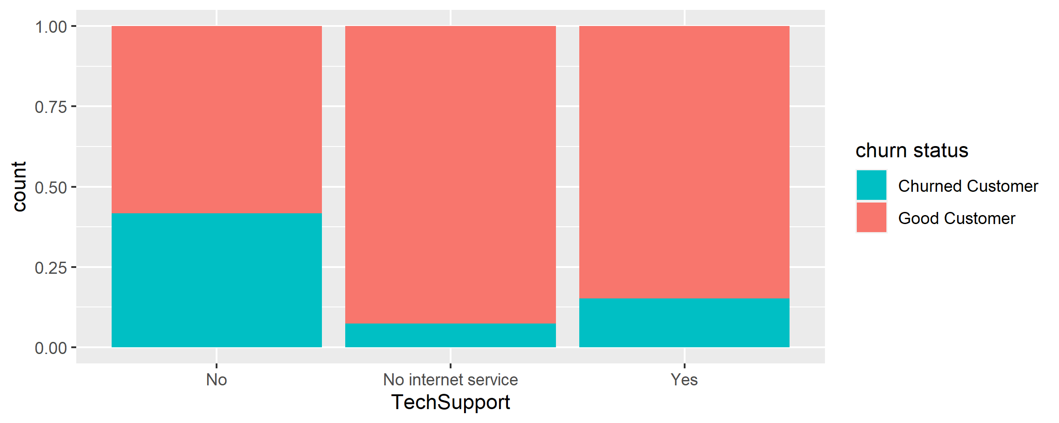
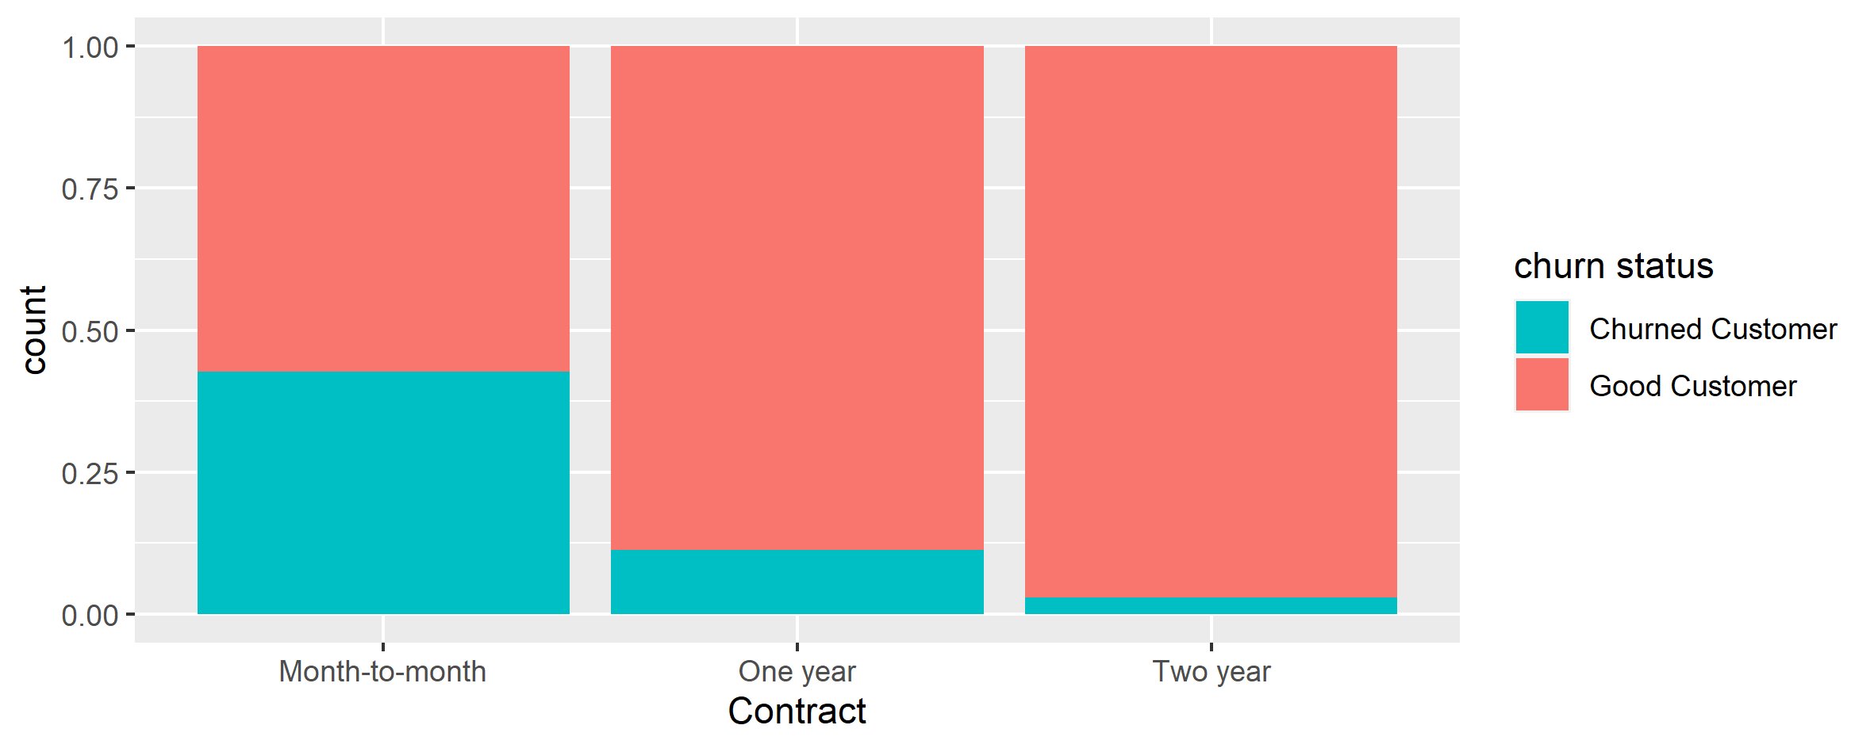

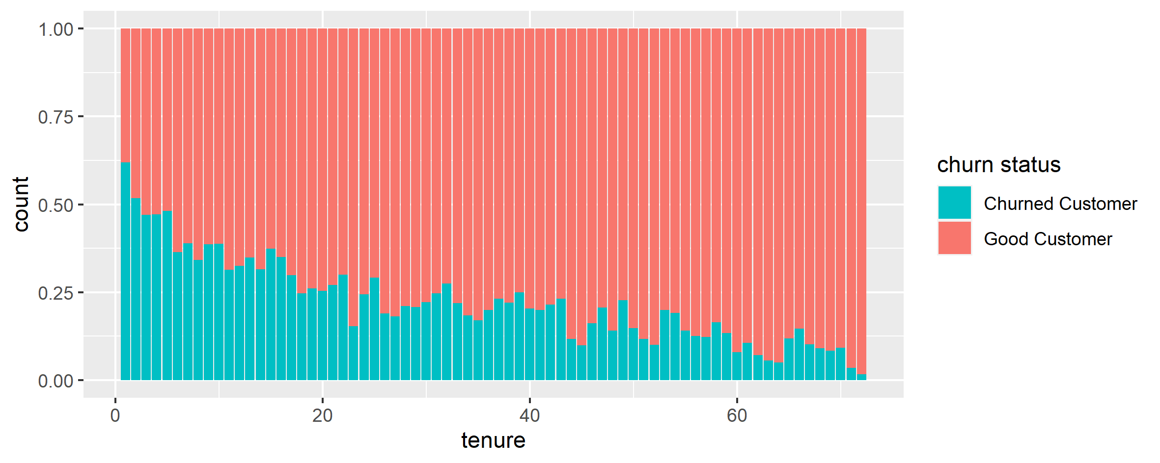
Service dimension analysis
Customer likely to Churn

Slide 5
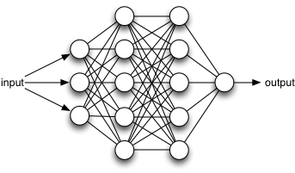
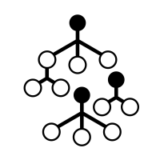
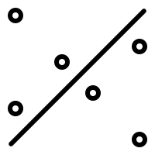
MODELLING
In this Project we are using three machine learning model namely
Artificial Neural Network
Random Forest
Support Vector Machine
Artificial Neural Networks (ANN) are now a staple within the sub-field of Machine Learning.
Deep learning algorithms can be vastly superior to traditional regression and classification methods.
The ability to model interactions between features that would otherwise go undetected
The challenge becomes explainability, which is often needed to support the business case. The good news is we get the best of both worlds with keras and lime.
Random Forest is often known as an ensemble of a large number of Decision Trees.
As bootstrapped aggregation technique to choose random samples from a dataset to train each tree in the forest. The final prediction in a Random Forest is an aggregation of prediction of individual trees.
One of the advantages of Random Forest is that, it gives out-of-bag(OOB) error estimates, which is the mean prediction error on a training sample, using the trees that do not have that training sample in their bootstrap sample.
The advent of computers brought on rapid advances in the field of statistical classification, one of which is the Support Vector Machine, or SVM.
The goal of an SVM is to take groups of observations and construct boundaries to predict which group future observations belong to based on their measurements.
SVMs can take almost any shape (including linear, radial, and polynomial, among others), and are generally flexible enough to be used in almost any classification endeavor that the user chooses to undertake.

Slide 6
RANDOM FOREST
Process of Random forest
Selection Process
Prediction
First, start with the selection of random samples from a given dataset
Then it will get the prediction result from every decision tree.
Splitting of Data
Voting
Training (75%) and Testing (25%)
train_tbl <- train_test_split %>% training()
test_tbl <- train_test_split %>% testing()
In this step, voting will be performed for every predicted result.
Implement
Final Output
The algorithm will construct a decision tree for every sample
At last, select the most voted prediction result as the final prediction result.

Slide 7
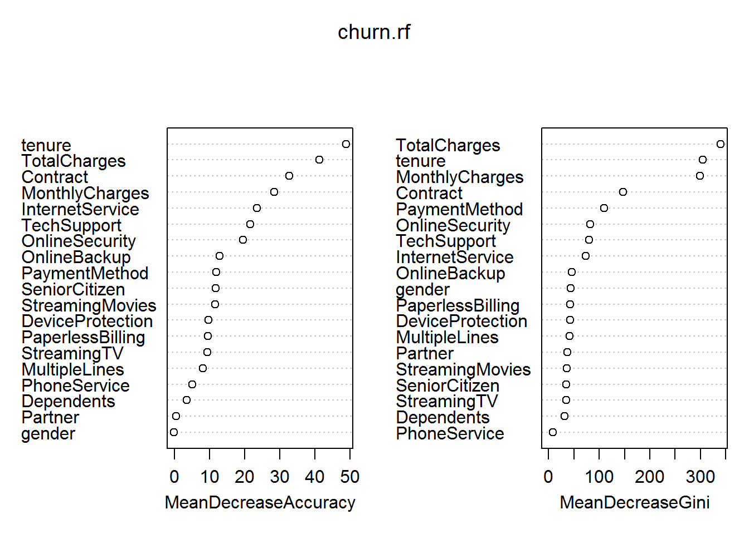
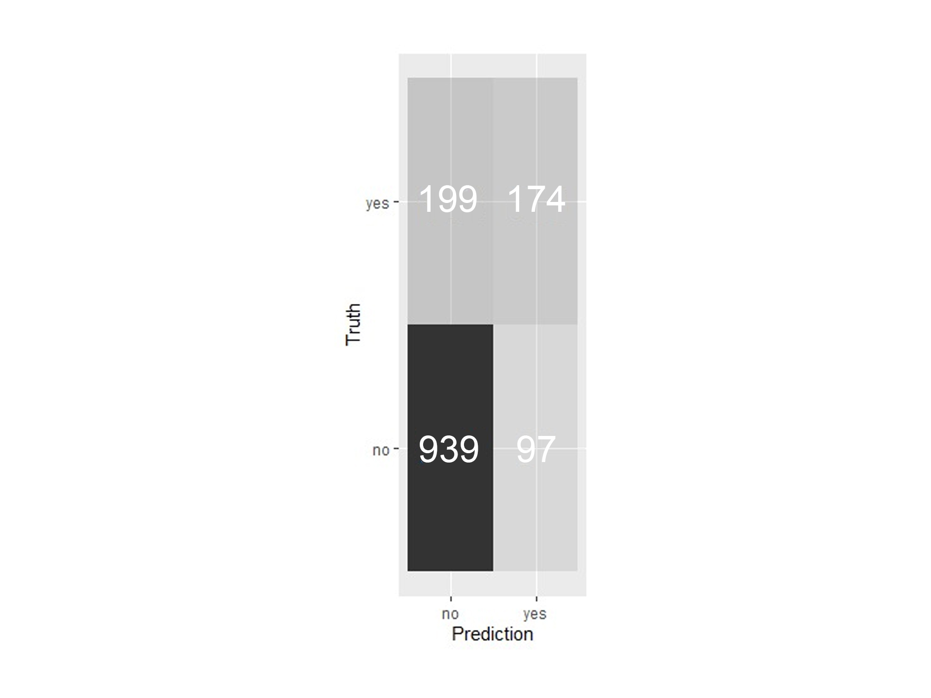
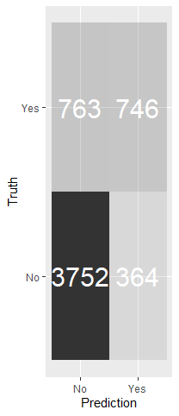
Random Forest
Improvement’s and Drawback
The accuracy has remained virtually unchanged, with a value of 75.683%
There’s two measures of feature importance that are reported, mean decrease in accuracy, and mean decrease in gini.
Random forest uses multiple decision trees to make predictions. Single decision trees on their own can be very effective at learning non-linear relationships
Rather than try a different subset of features, I’ll try to tune some of the parameters of the random forest model. First i added cross validation(10-fold) . Right now the default is 10 different test value with equal distribution, and 3 repeation so after try several numbers, the accuracy improve with a value of 80.583%
Due to their high variance, they tend to over-fit.
precision | 0.8328118
recall | 0.9050279
f_meas | 0.8674194
Accuracy : 0.78683
## 95% CI : (0.7846, 0.8223)
## No Information Rate : 0.7347
## P-Value [Acc > NIR] : 6.588e-12 ##
## Kappa : 0.4708
## Mcnemar's Test P-Value : 0.000106
## Sensitivity : 0.5525
## Specificity : 0.8948
## Pos Pred Value : 0.6548
## Neg Pred Value : 0.8470
## Prevalence : 0.2653
## Detection Rate : 0.1466
## Detection Prevalence : 0.2239
## Balanced Accuracy : 0.7236
## 'Positive' Class : Yes
Accuracy : 0.80583
## 95% CI : (0.7917, 0.8288)
## No Information Rate : 0.7347
## P-Value [Acc > NIR] : 4.239e-14 ##
## Kappa : 0.4877
## Mcnemar's Test P-Value : 3.117e-05
## ## Sensitivity : 0.5610
## Specificity : 0.9010
## Pos Pred Value : 0.6718
## Neg Pred Value : 0.8504
## Prevalence : 0.2653
## Detection Rate : 0.1489
## Detection Prevalence : 0.2216
## Balanced Accuracy : 0.7310 ##
## 'Positive' Class : Yes

Slide 8
Support Vector Machine
Workflow of SVM
Pre-processing data
Linear kernel
Convert to categorical/factor variables.
Binning the Parameter’s (0,1,2)
It is mostly used when there are a Large number of Features in a particular Data Set. ... Training a SVM with a Linear Kernel is Faster than with any other Kernel.
Train test split
Radial kernel
intrain <- createDataPartition(y = cust_data$Churn, p = 0.8, list = FALSE, times = 1)
training <- cust_data[intrain,]
testing <- cust_data[ - intrain,]
This is a popular kernel function used in various kernelized learning algorithms. In particular, it is commonly used in support vector machine classification.
Final Output
Hyper parameter tuning
The model correctly identifies testing observations. SVMs and the boundaries they impose are more difficult to interpret at higher dimensions, but these results seem to suggest that our model is a good classifier for the gene data.
Choosing a set of optimal hyperparameters
for a learning algorithm.

Slide 9
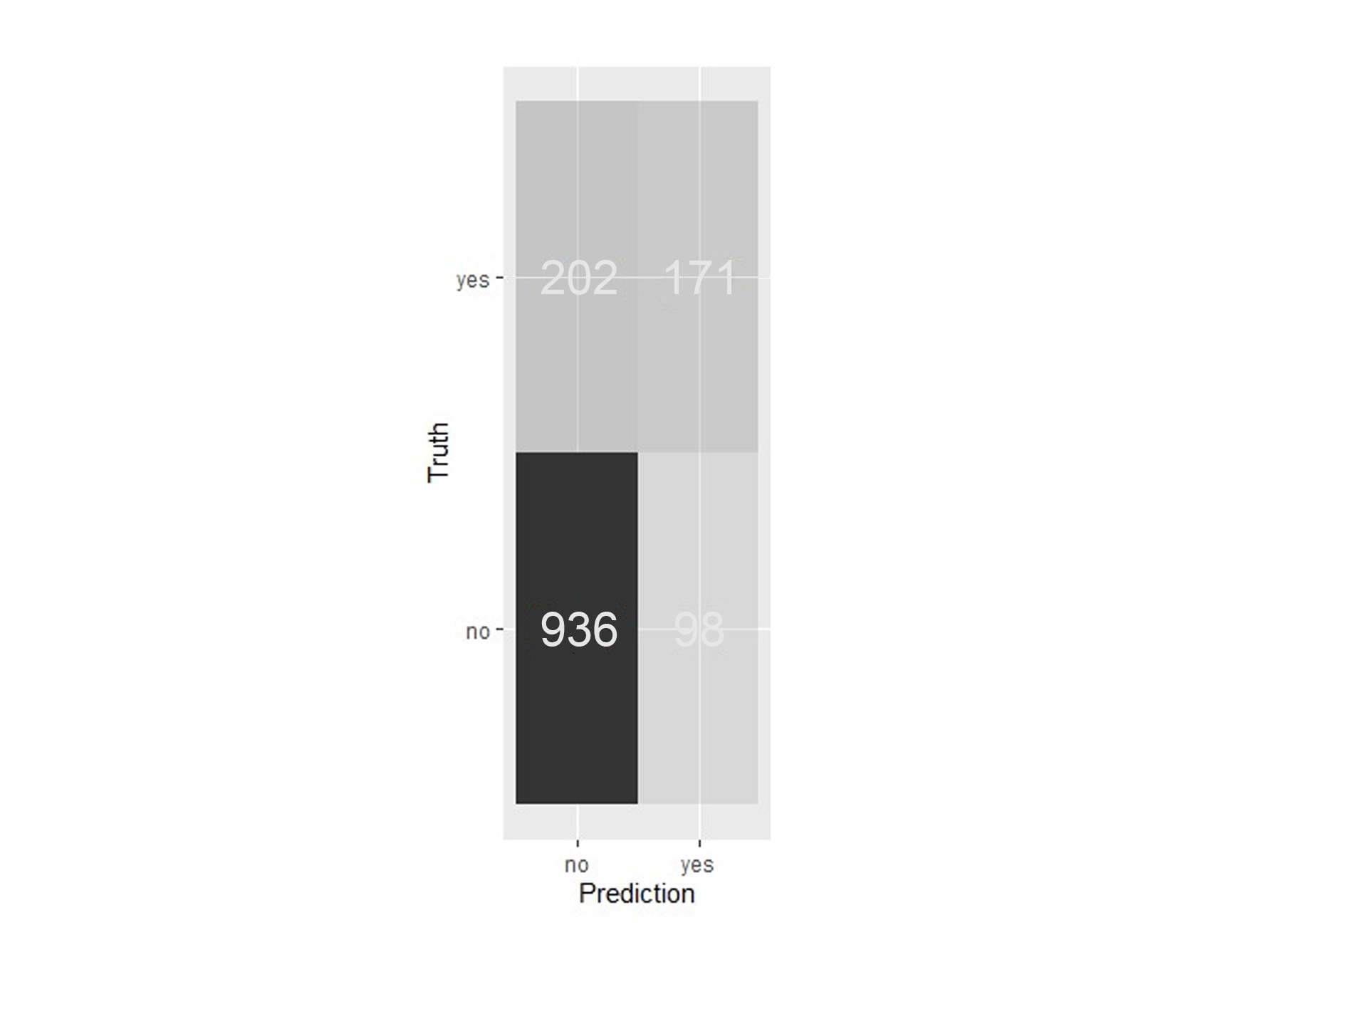

Tune the model using train function Linear and radial kernel and check the results
Linear
Radial
SVM-Kernel: linear
cost: 0.01
parameter : cost C = 20
Gaussian Radial Basis kernel function.
Hyperparameter : sigma = 0.001
tune.svm = tune(svm,as.factor(Churn)~.,data=training,
kernel="linear",
ranges = list(cost=c(0.0001,0.001,0.01,0.1,1,10,100,1000)))
tune.svm$best.model
tune_ksvm <- train(as.factor(Churn)~.,data=training,method="svmRadial",
tuneGrid=expand.grid(sigma=c(0.001,0.01,0.1,1,0.0001),
C=c(0.01,0.1,1,20,21,22,23,24,25,26,27,28,29,1,10,30,40,50)),
metric="Accuracy",trControl=trainControl(method='repeatedcv',
number=5,repeats=10))

Slide 10
Artificial Neural Network
Creating ANN Model using Keras package
Initializing a sequential model.
The sequential model is composed of a linear stack of layers.
.
Step1
Applying layers to the sequential model
Layers consist of the input layer, hidden layers and an output layer. The hidden layers and output layers are what controls the ANN inner workings.
Step 2
Compiling the model.
The last step is to compile the model with optimizer Adam.
Step 3
Final Output
The investigate features that are most frequent in the LIME feature importance visualization along with those that the correlation analysis.
Step 4

Slide 11
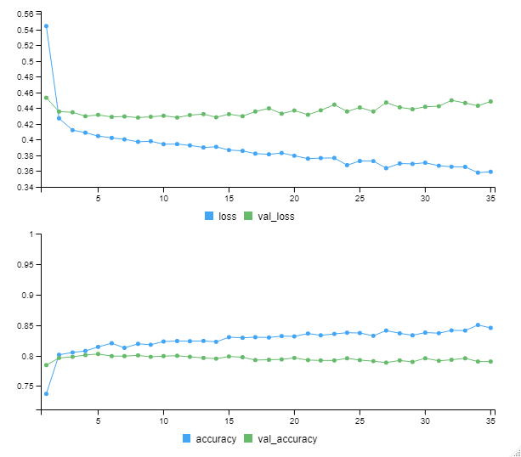
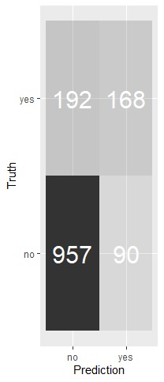
Visualizing the Keras training history.
After the model creation we fit the model. The batch_size = 50 sets the number samples per gradient update within each epoch. We set epochs = 35 to control the number training cycles. Typically we want to keep the batch size high since this decreases the error within each training cycle (epoch). We also want epochs to be large, which is important in visualizing the training history.
What we want to see is the validation accuracy and loss leveling off, which means the model has completed training. We see that there is some divergence between training loss/accuracy and validation loss/accuracy.
Only use enough epochs to get a high validation accuracy. Once validation accuracy curve begins to flatten or decrease, it’s time to stop training.
After completion of the model creation and fitting the model we now calculate accuracy, precession, recall and F1 score
from the confusion matrix.
We calculated the accuracy from the matrix and found to be 0.88952.
Precision and recall are very important to this model since the main aim of the project is balancing the cost of targeting and
retaining customers at risk of leaving with the cost of targeting customers that are not planning to leave.
Precision: 0.789
Recall: 0.623

Slide 12
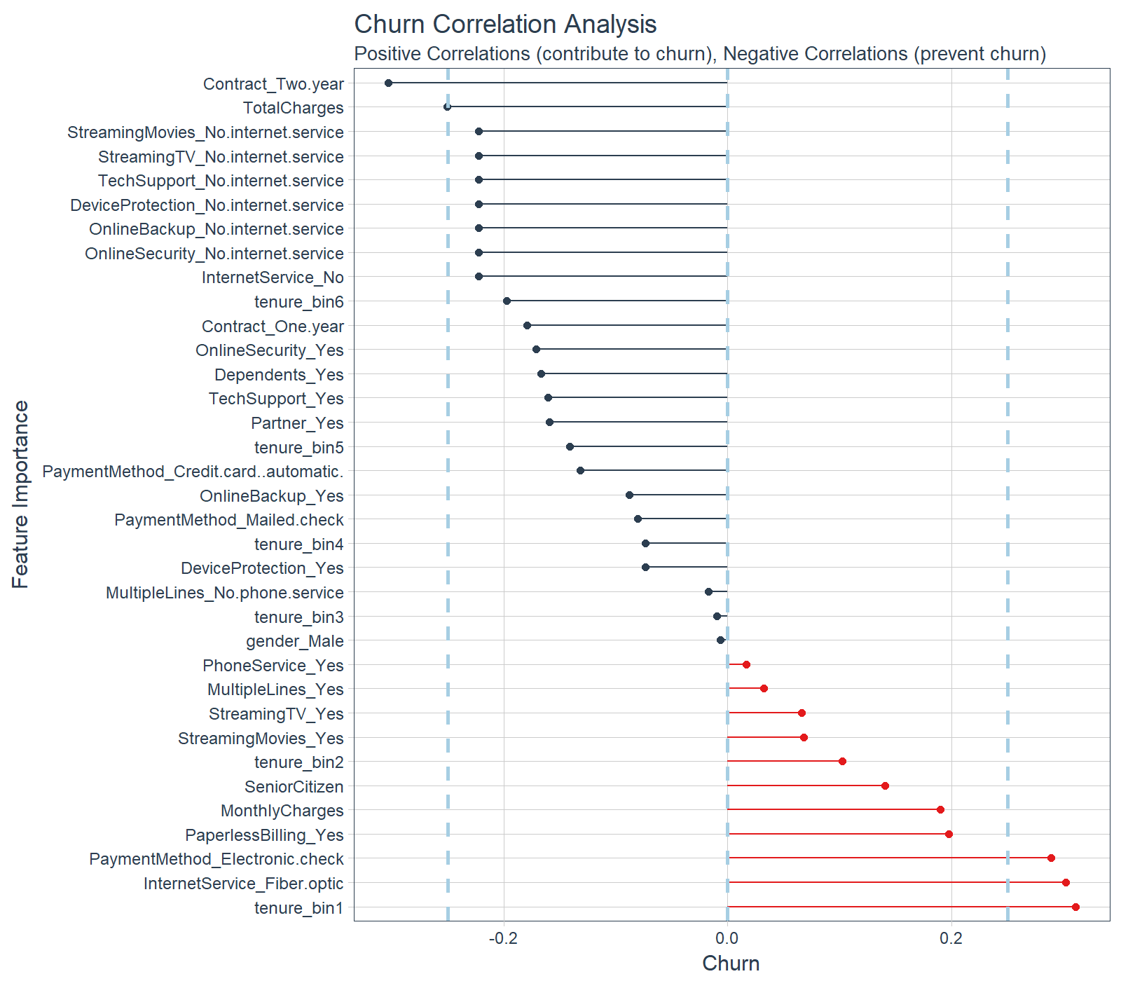
Check Explanations With Correlation Analysis
The correlation visualization helps in distinguishing which features are relavant to Churn.
The correlation analysis helps us quickly disseminate which features that the LIME analysis may be excluding. We can see that the following features are highly correlated (magnitude > 0.25):
Increases Likelihood of Churn (Red):
Tenure = Bin 1 (<12 Months)
Internet Service = “Fiber Optic”
Payment Method = “Electronic Check”
Decreases Likelihood of Churn (Blue):
Contract = “Two Year”
Total Charges (Note that this may be a biproduct of additional services such as Online Security)

Slide 13
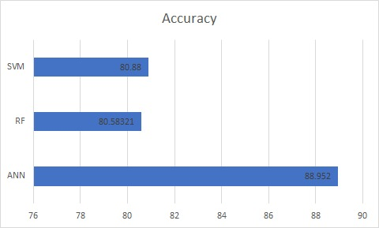
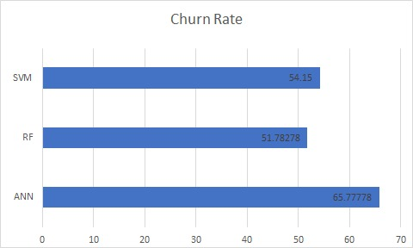
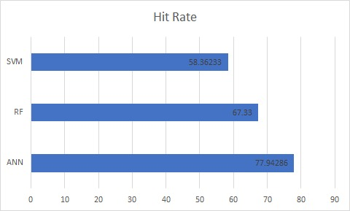
Comparison Analysis
Model Difference as per to their Performance.
The rate of attrition or customer churn, is the rate at which customers stop doing business with an entity. It is most commonly expressed as the percentage of service subscribers who discontinue their subscriptions within a given time period.
#Churn Rate
TN <- confmat$table[1]
FP <- confmat$table[2]
FN <- confmat$table[3]
TP <- confmat$table[4]
churn_rate = TN / FP + TN
#HIT Rate
TN <- confmat4$table[1]
FP <- confmat4$table[2]
FN <- confmat4$table[3]
TP <- confmat4$table[4]
hit_rate = TN / FN + TN

Slide 14
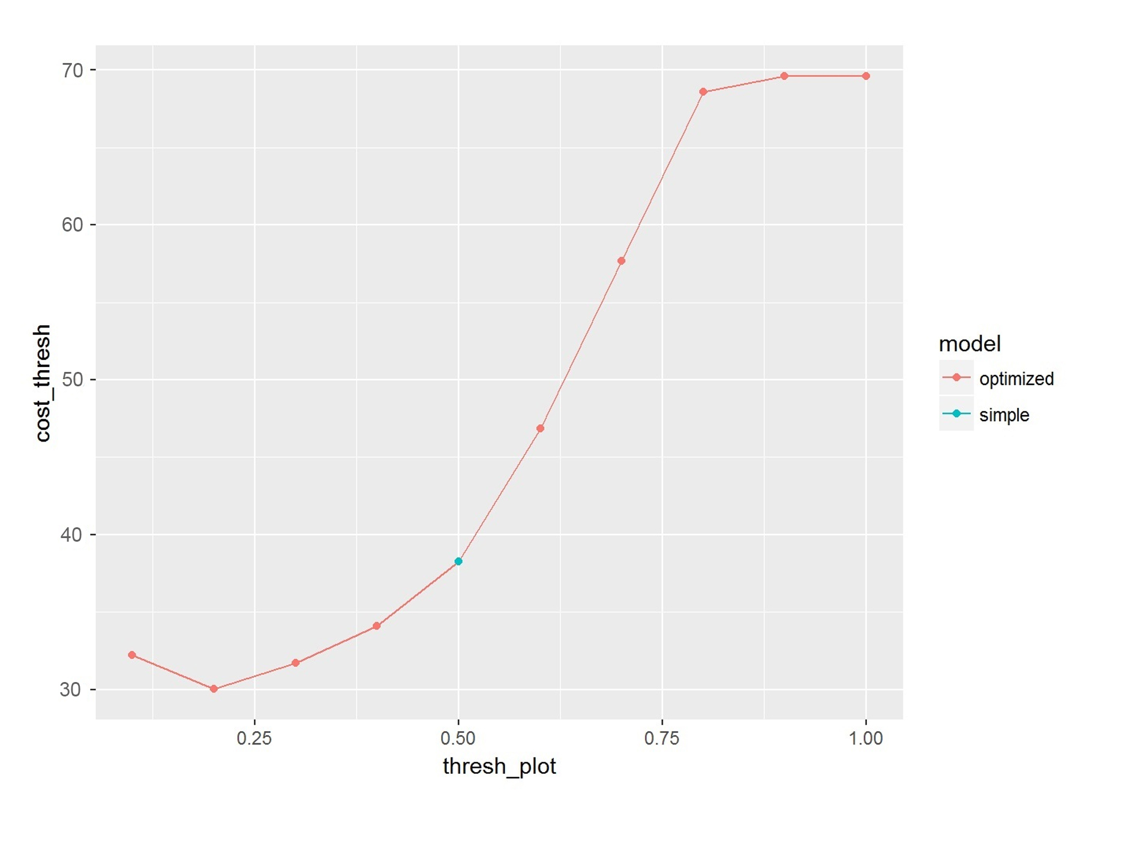
CONCLUSION
Cost Evaluation
01
All of the previous modeling and evaluation metrics were useful, but they don’t tell us much about the actual impacts on the business To start, I’ll make several assumptions related to cost. Doing a quick search, it looks like the customer acquisition cost in the telecom industry is around 300. I’ll assume that my customer retention costs are 60.
cost = FN(300) + TP(60) + FP(60) + TN(0)
02
Since the ANN model seemed to perform slightly better, I’ll use that model.
TN <- x$table[1]/1760
FP <- x$table[2]/1760
FN <- x$table[3]/1760
TP <- x$table[4]/1760
cost_simple = FN*300 + TP*60 + FP*60 + TN*0
savings_per_customer = cost_simple - min(cost)
total_savings = 500000*savings_per_custome
dat <- data.frame( model = c(rep("optimized",10),"simple"),
cost_thresh = c(cost,cost_simple), thresh_plot = c(thresh,0.5) )
03
If we assume that our baseline model is the ANN model with a threshold of 0.5, the cost associated with this model is 38.28409/customer.
If we optimize the model and use a threshold of 0.2, our customer retention cost is reduced to 30.26478/customer.
Assuming a customer base of 500,000 this comes out to a yearly savings of over 19142045.
04
This example illustrates the value of optimizing a machine learning model for accuracy, as well as impact on the business.

Slide 15
Improvements to Reduce Churn
Use incentives to create non-cash mobile rewards programs.
THANK YOU
Constantly answer customer feedback on all channels. Especially social media.
Anticipate churn by investing in better technology.
Resolving Customer Service Issues.
Managing Customer Lifetime Value.
Big Data Analytics Platforms for Reducing Churn.

